Slide 1
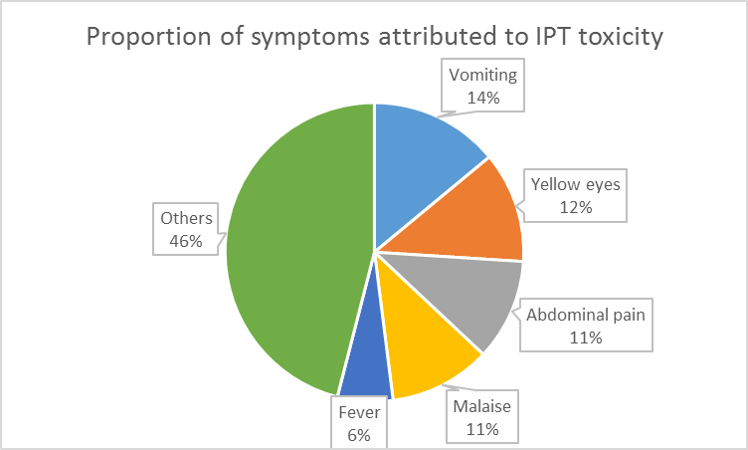
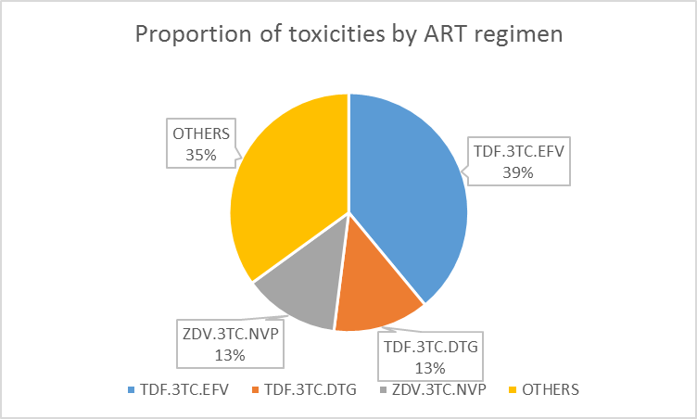
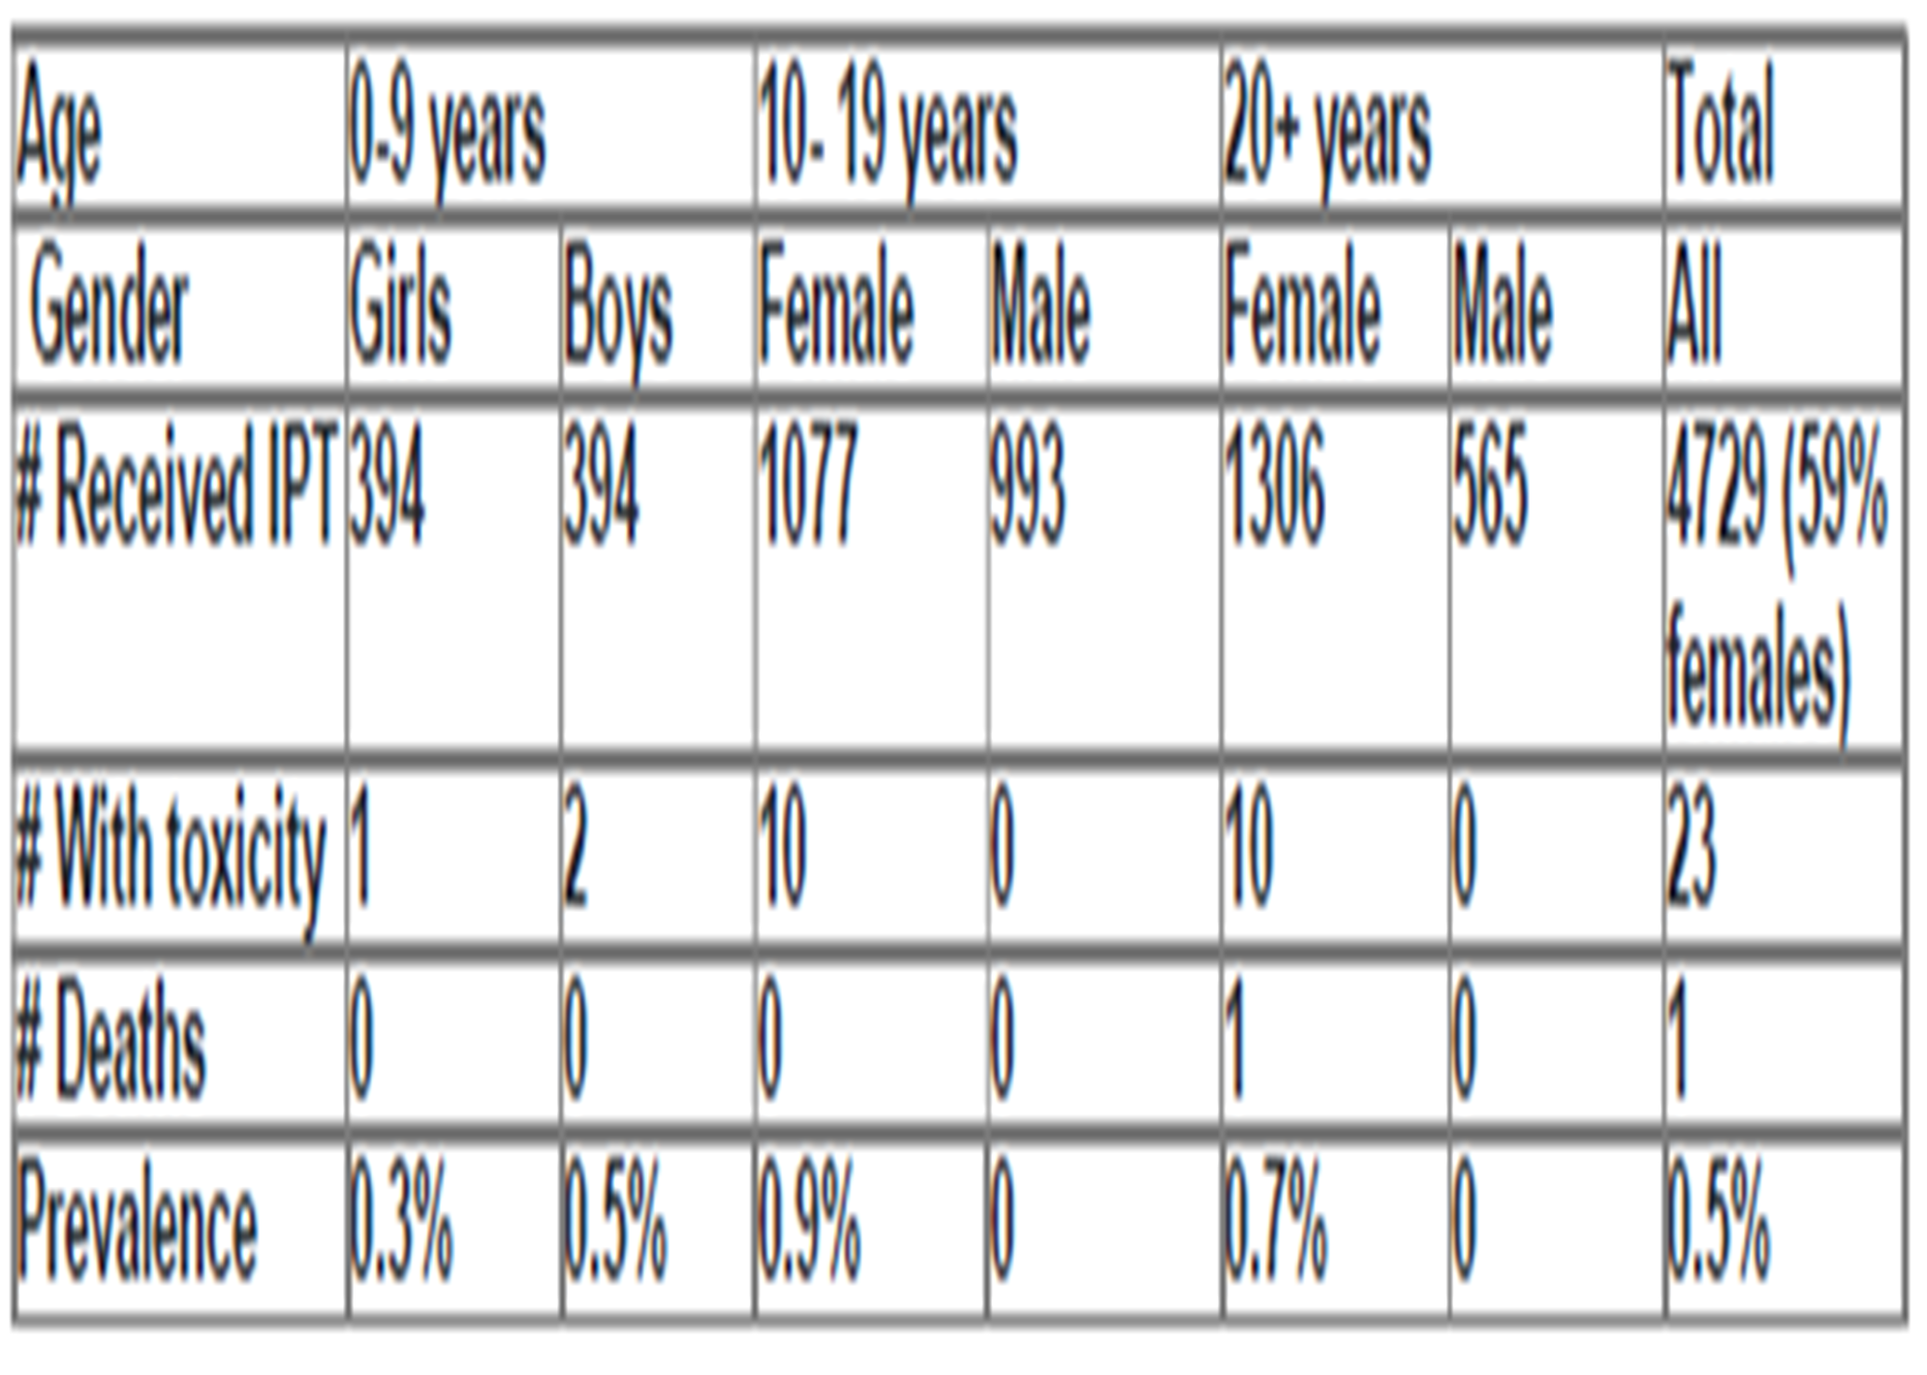
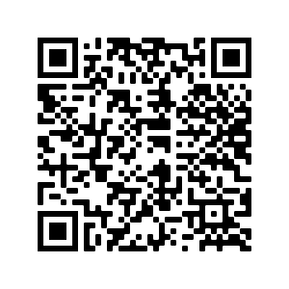
PEB0358: Isoniazid tuberculosis preventive therapy toxicity among HIV-positive children, adolescents and adults in Uganda
J. Kanywa¹, M. Mugerwa¹, A. Kekitiinwa¹, M. Adler²
¹Baylor College of Medicine Children's Foundation Uganda, Medical, Kampala, Uganda, ²Division of Global HIV & TB/ Centers for Disease Control and Prevention (DGHT/ CDC), Global HIV & TB, Kampala, Uganda
BACKGROUND
A 6 months course of Isoniazid tuberculosis preventive therapy (IPT) is being scaled up in Uganda but little is known about its toxicity in antiretroviral therapy experienced children, adolescents and adults.
We describe IPT toxicity among these populations at an urban HIV clinic in Uganda during the national scale-up.
METHODS
We retrospectively reviewed IPT toxicity reports for the period Jan-Jul 2019.
We included all people living with HIV (PLHIV) who were on isoniazid preventive therapy for TB prevention.
Variables studied included; age, sex, duration on IPT, toxicity symptoms, time to onset of symptoms, severity, ART duration, regimen and co- morbidities.
We used Division of AIDS (DAIDS) toxicity grading.
We performed descriptive analysis.
INH toxicity events were reported as proportions.
Severe toxicity due to Isoniazid tuberculosis preventive therapy occurred mostly in the first month of treatment, especially among older adolescent girls.
RESULTS
Median duration on IPT was 1 month (IQR, 1–3) and on current antiretroviral treatment regimen was 8 months (IQR, 3–46). Median age with toxicity events was 19 years (14- 34.5) (table 1).
Three-quarters of IPT-toxicity events were DAIDS grades 3 or 4 with no co-morbidities.
Table 1. Prevalence and outcome of INH toxicity.
CONCLUSIONS
Health workers should suspect toxicity in the first month of IPT especially among symptomatic older adolescent girls.
This project has been supported by the President’s Emergency Plan for AIDS Relief (PEPFAR) through CDC Uganda under the terms of 1NU2GGH0022-01-00.
The findings and conclusions in this report are those of the author(s) and do not necessarily represent the official position of the Centers for Disease Control and Prevention.
jbalungi@gmail.com
PRESENTED AT THE 23RD INTERNATIONAL AIDS CONFERENCE (AIDS 2020) | 6-10 JULY 2020

